Slide 1
Cookbook app
Chaya Turner. Hana Ryzhuk
Prof. Novick, MCO 152

Slide 2
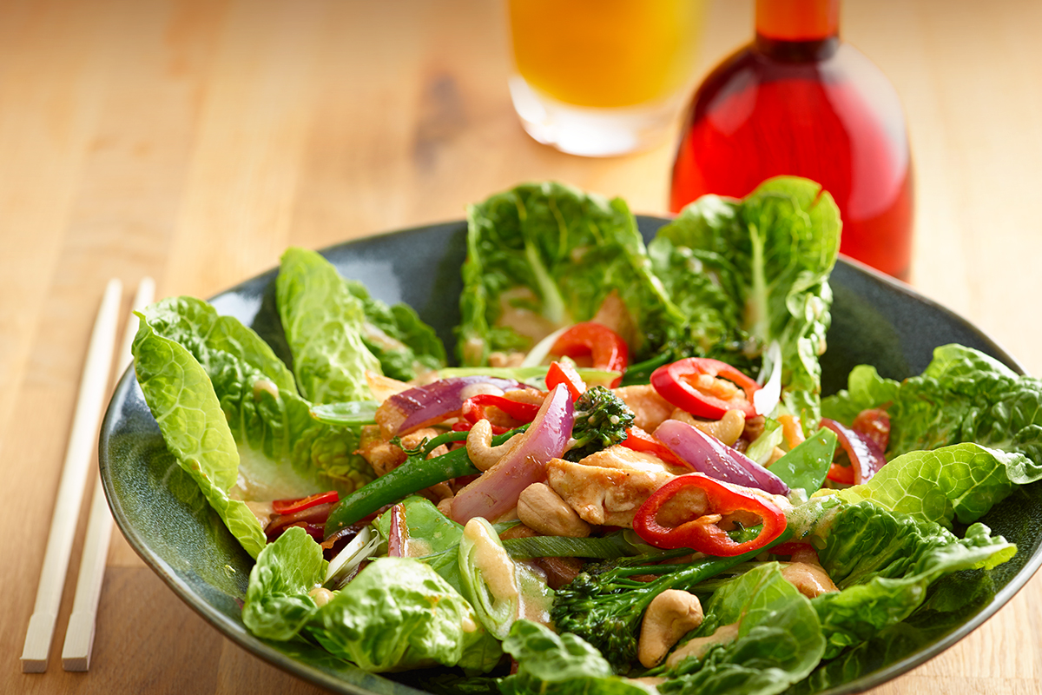
Are you starving?
You need a convenient spot (besides your stomach) to store all of your favorite recipes?

Slide 3
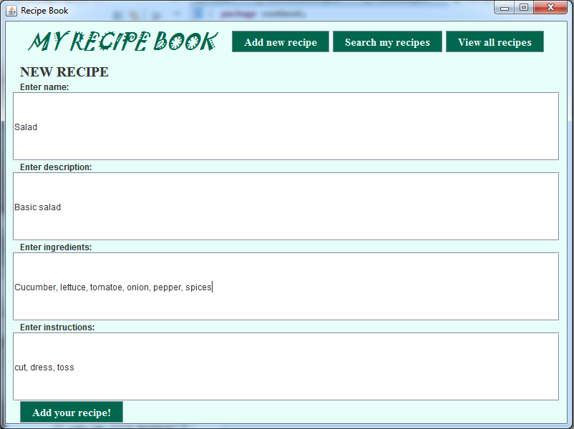
No questions. Our program lets:
To add new recipe

Slide 4
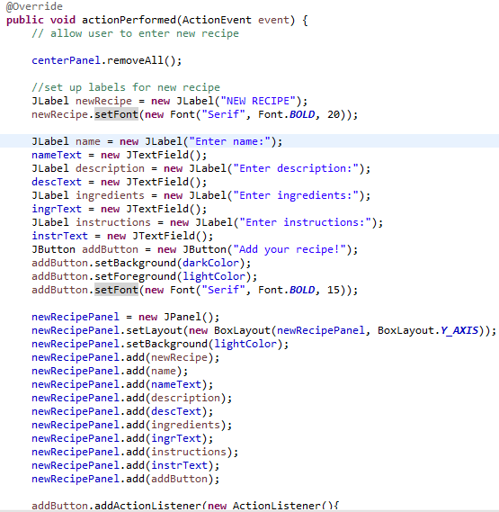
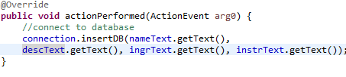
New recipe code
MenuGUI class ⇨

Slide 5
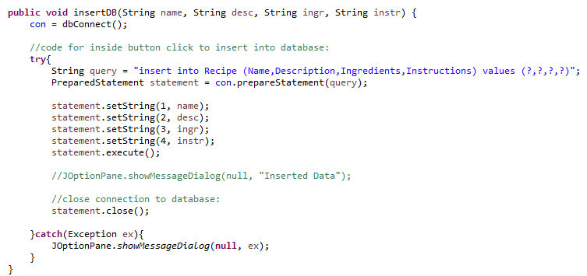
New recipe code
DBConnection class ⇩

Slide 6
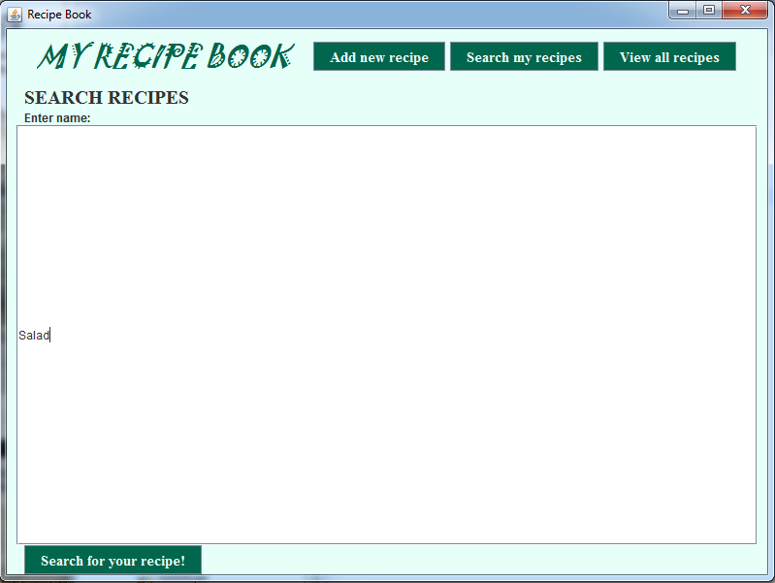
Want to find your diet salad? Not a problem.
Just use a search

Slide 7
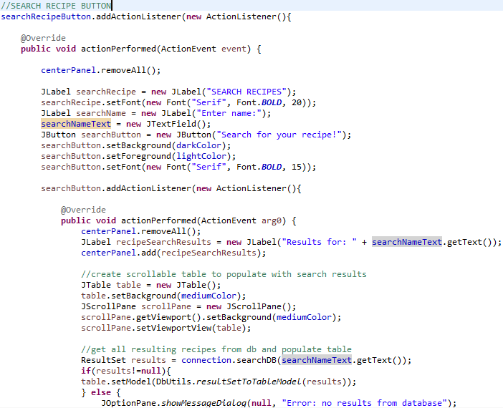
Search code
MenuGUI
class ⇨

Slide 8
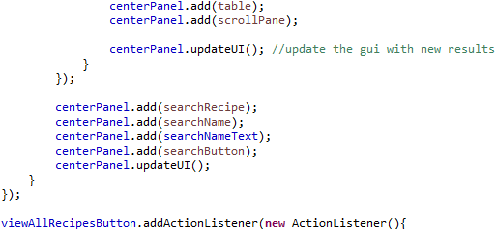
Search code
MenuGUI
(continued)

Slide 9
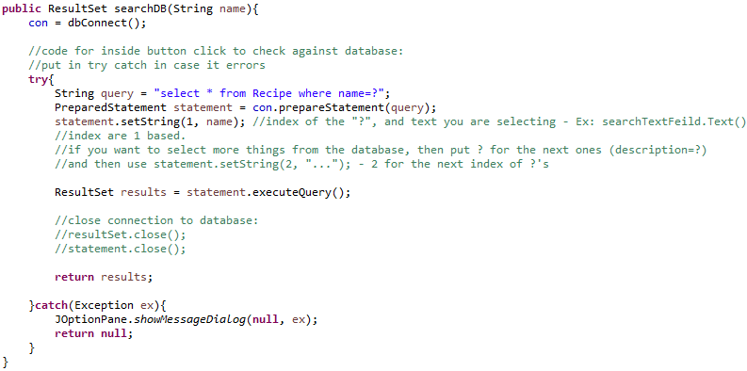
Search code
DBConnection class ⇩

Slide 10
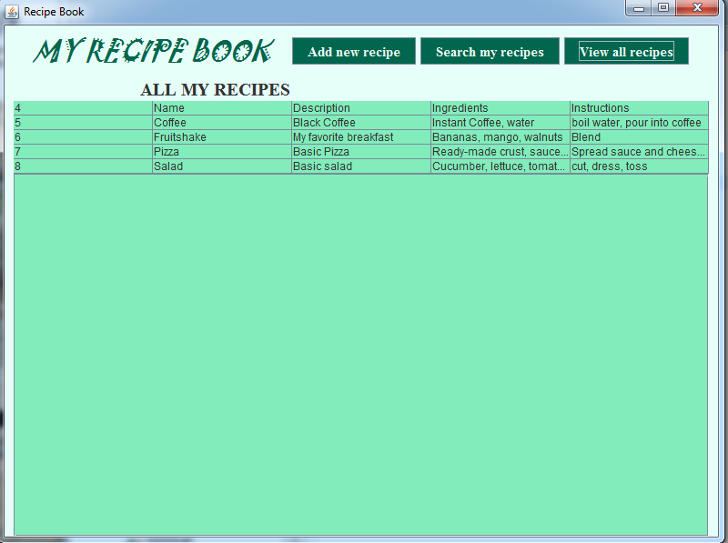
Not sure what you want to have for supper?
Check a list of all recipes.

Slide 11
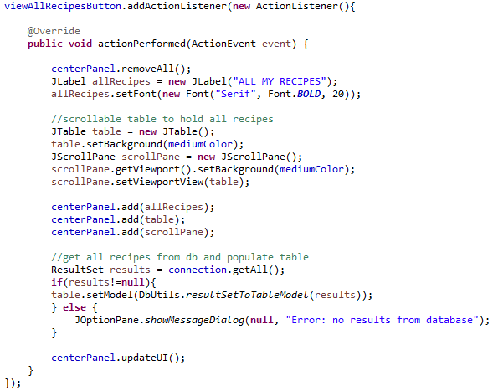
All recipes code
MenuGUI
class ⇨

Slide 12
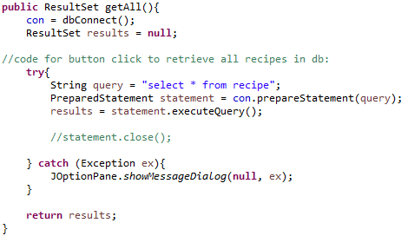
All recipes code
DBConnection class ⇩

Slide 13
Where do we save our recipes?
We used a local database called SQLite database. This database may be stored on each computer individually.
To create database, we used special managers, as SQLiteStudio and Firefox SQLite Manager.
Manager is connected to the GUI code. It means that everything added to the database through our program, will be showed in SQLite manager app.

Slide 14
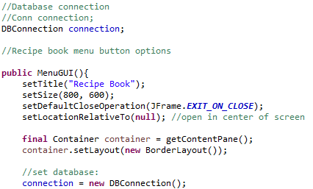
SQLite database code
MenuGUI
class ⇨
connection we used after, in each method as add, view and search

Slide 15
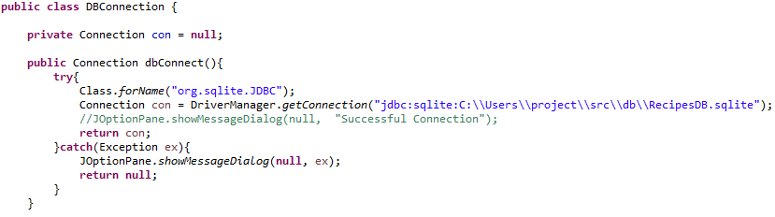
SQLite database code
DBConnection class ⇩

Slide 16
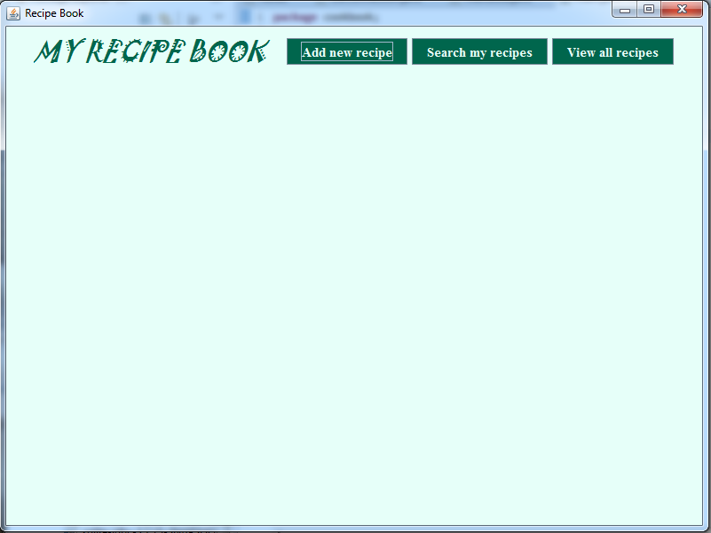
And here is a main menu.

